Slide 1


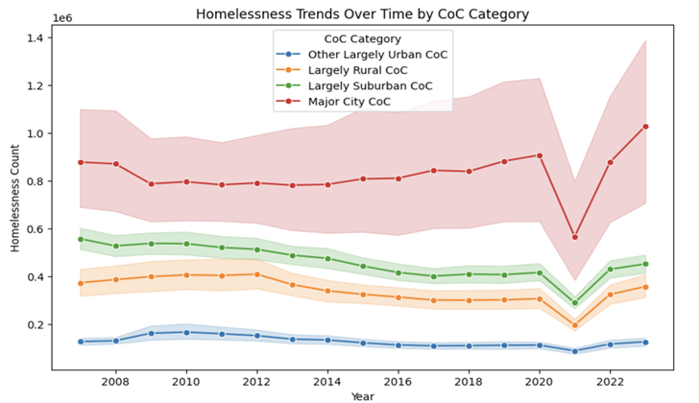
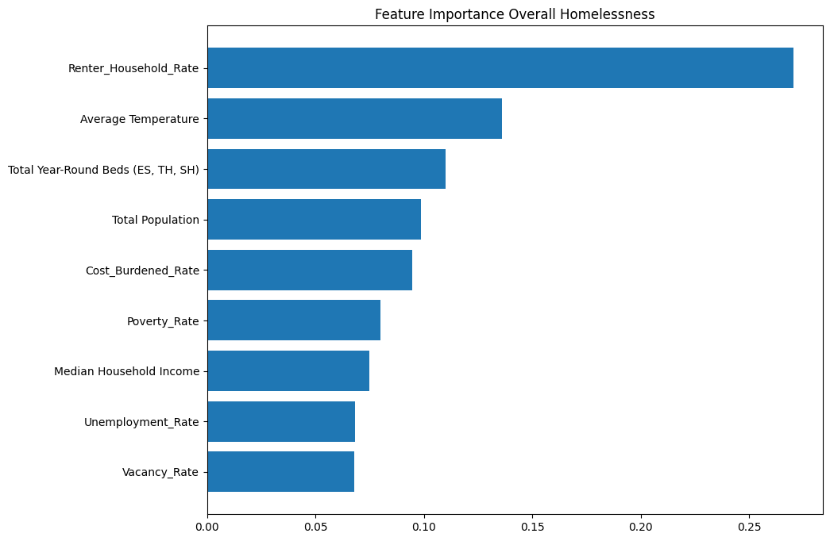
Predictive Model Based on Homelessness
PROJECT SUMMARY
This project aims to develop a predictive model of homelessness across 400 Continuums of Care in the U.S., which annually report homelessness counts. Using data from 2007-2023, the project explores the influence of structural factors such as rent, poverty, and other socioeconomic conditions on homelessness rates. It seeks to forecast homelessness trends and identify key community-level predictors.
HOMELESSNESS INSIGHTS
PROJECT RESULTS
We performed xgboost and cross validation and tracked RMSE and R squared for homelessness types under consideration.
CONCLUSION
Our project shows that Renter Household Rate, Total Population, and Total Beds are most influential variables. This demonstrates community level housing, socioeconomic conditions are essential in predicting homelessness trends.
TYPE (PER CAPITA) | RMSE | R²
Overall | 0.43 | 0.42
Individuals | 0.43 | 0.18
Families | 0.38 | 0.18
Unsheltered | 0.42 | 0.45
Sheltered | 0.41 | 0.28
PROJECT QUESTIONS
To what extent community-level measures of rent, poverty, and other housing market conditions accurately predict the number of persons experiencing homelessness in a community?
What community-level measures are most important in predicting the number of persons experiencing homelessness in a community?
TEAM MEMBERS
Syeda Aqeel
Shiheng Xu
Samritha Ravikumar
Kunshu Yang
Renjie Fan
REFLECTIONS
Learning from interdisciplinary collaboration
Value of data preprocessing
Importance of communication and iteration
CLIENTS & MENTORS
Clients: Dr. Tom Byrne,
Dr. Molly Richard
EIR: Tom Hopper
TPM: Dhruv Shah
PM: Jasmine Dong
TECH STACK
Languages & Libraries: Python, R, Pandas, Scikit-learn, dplyr, tidyr

